Slide 1

SAS Programming and Ap.Stats Final Project
Jason Larosiliere

Slide 2
Intro
For my project I decided to take a deeper look into NBA player stats. After finding the player stats for this year and last year’s NBA season on Sports Reference, I took 50 random players from each season along with their important core stats such as points per game, assist per game, rebounds per game, steals, blocks, field goal % and more. I also added 5 more x-variables myself which is position, what the player’s dominant hand is, height, starter or bench player, and whether they take a lot of shots which in this case is 17 or more shots per game. I want figure which stats are important in dictation whether a player shoots well from the field or is inefficient.

Slide 3
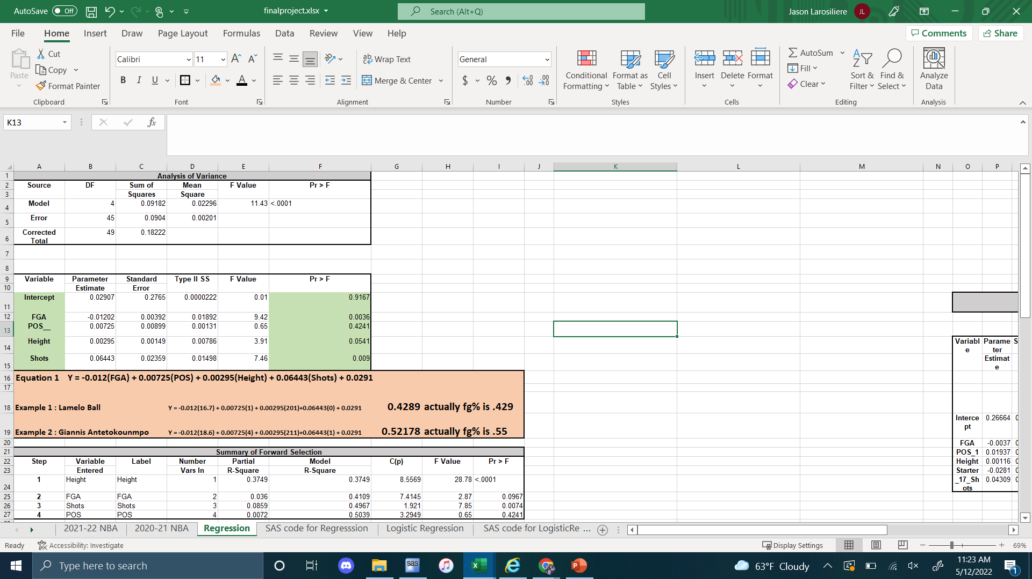
Full Regression w examples

Slide 4
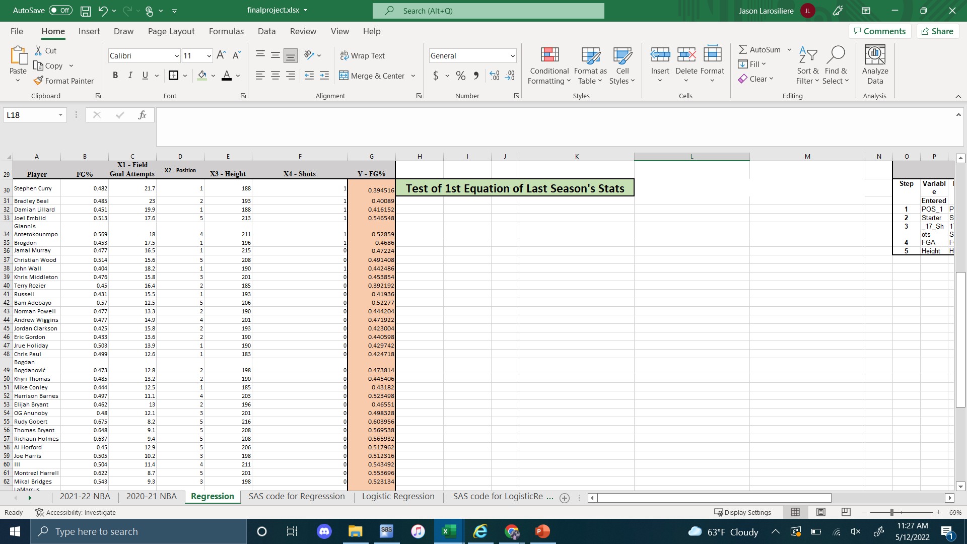
Equation tested on second set of data

Slide 5
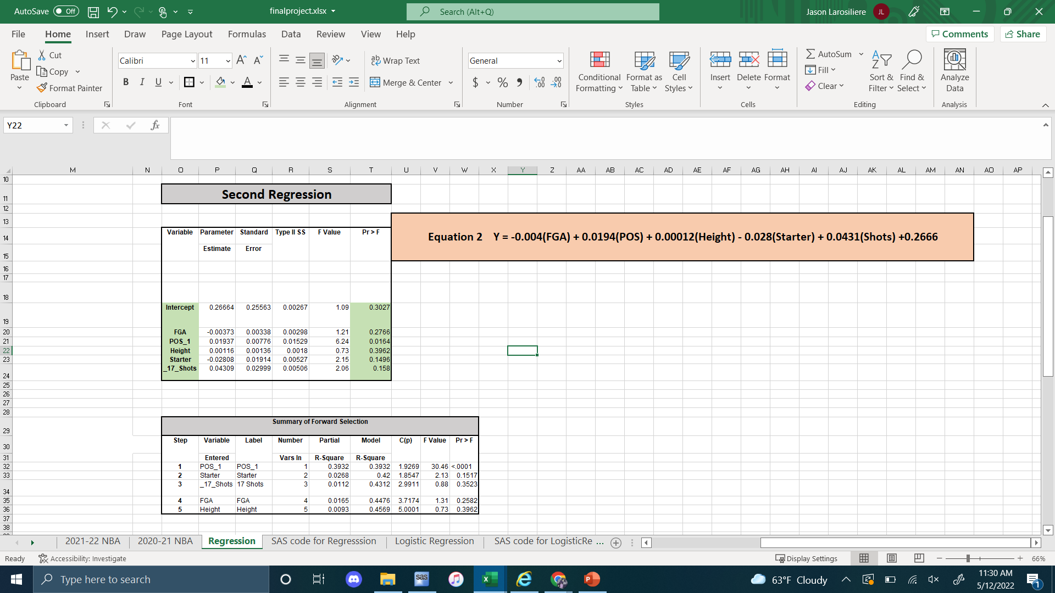
Second Regression- 2nd Data Set

Slide 6
Full Regression conclusion
After running the regression for the 2021-2022 recent NBA season we found the field goal attempts, height and the amount of shots you take all have low p-values which means they’re strong indicators for the field goal %. After testing the equation I got in the first regression on last season’s player stats I found that most of the field goal %s did not match with the actually % of each player. After running a new regression of the second set of player stats from last season. I found that it was very similar to the first regression except with x-variable of being starter coming up with a low p value.

Slide 7
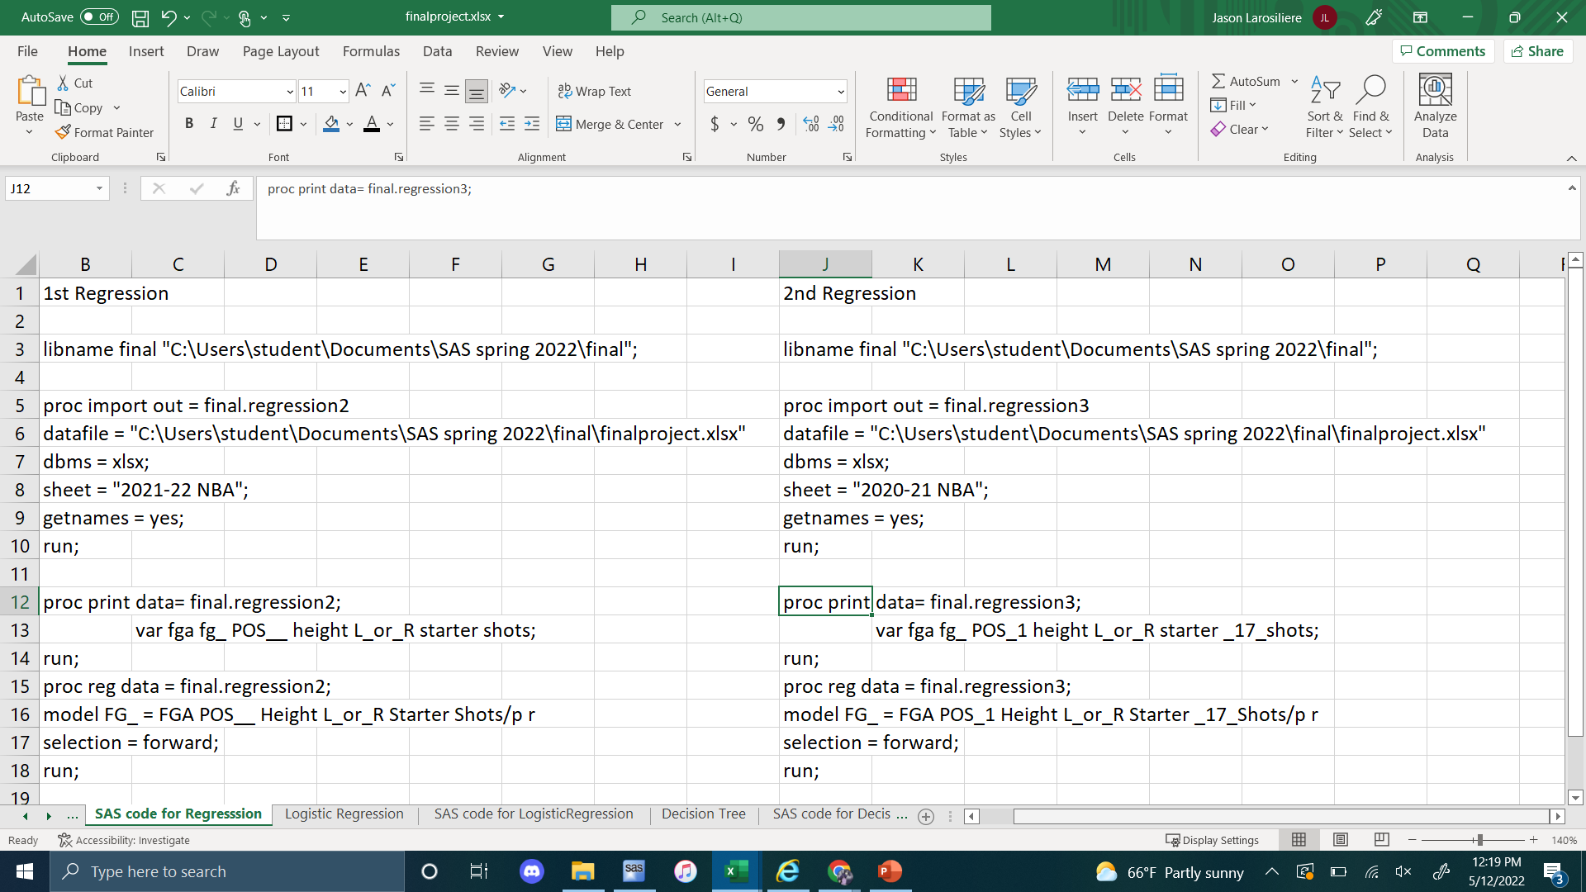
Full Regression SAS code

Slide 8
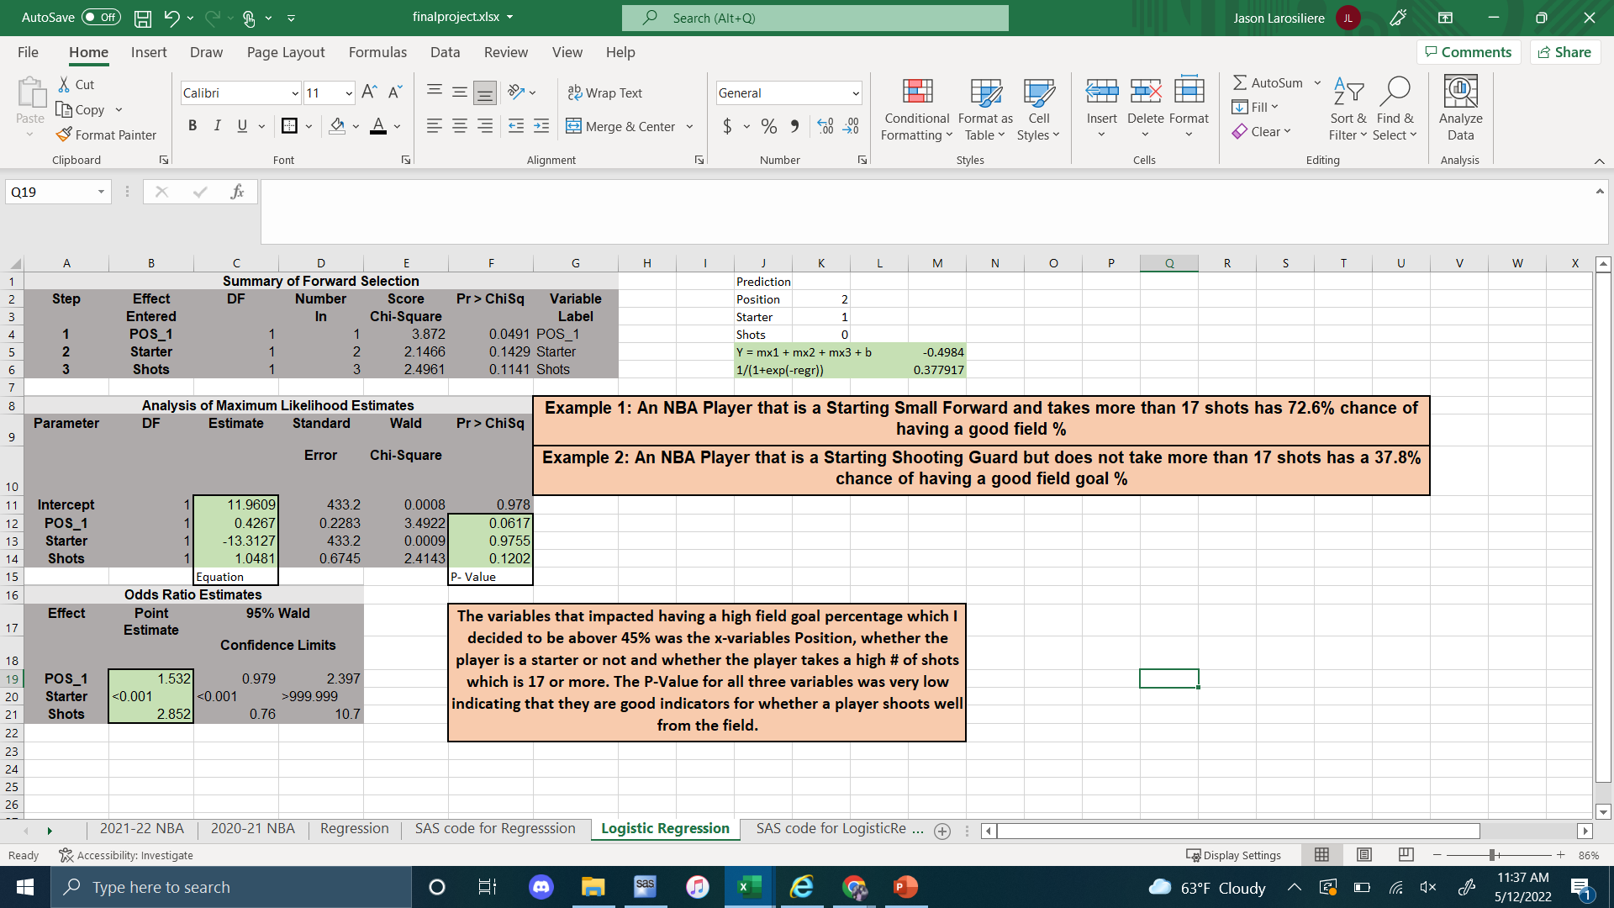
Logistic Regression

Slide 9
Logistic Regression conclusion
For the Logistic Regression, the y-variable field goal % was made into a 0 and 1 y-variable. I decided that shooting over 45% is a high % and shooting below this would be low %. However, this might end up being a bit misleading. Guards that shoot above 45% are considered to be shooting well, however a center that shoots below 50%(given he isn’t a stretch) would be an inefficient scorer. As a result, the variables that had an impact on Field Goal % was the position of the player, whether he starts or comes off the bench and whether he takes 17+ shots.

Slide 10
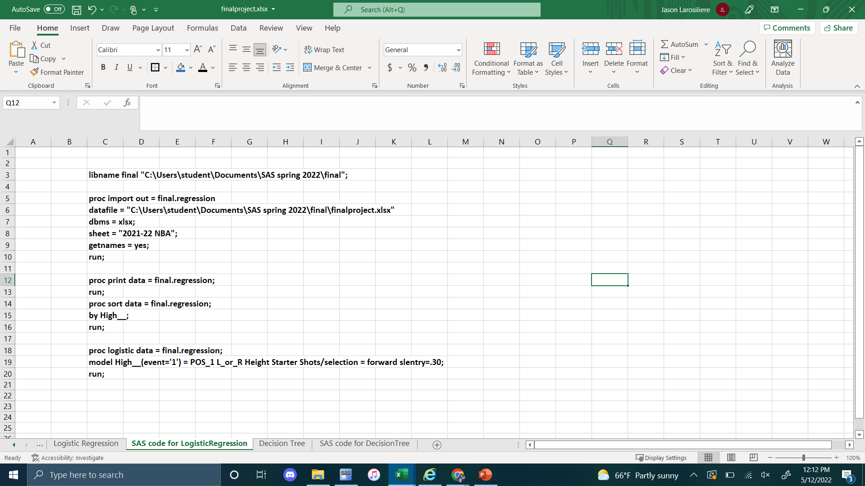
Logistic Regression SAS code

Slide 11
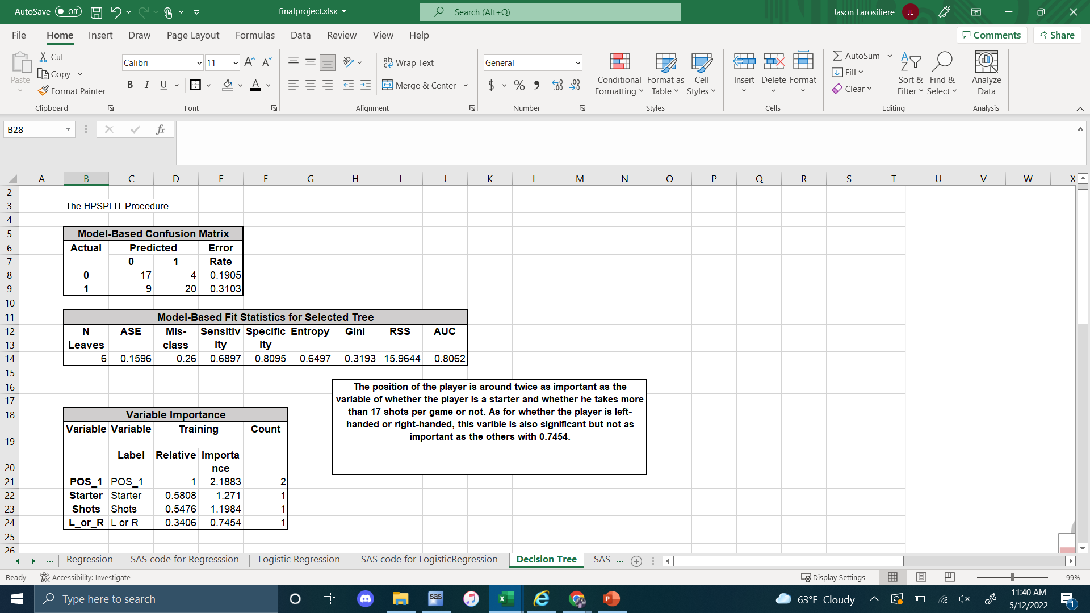
Decision Tree – Important Variables

Slide 12
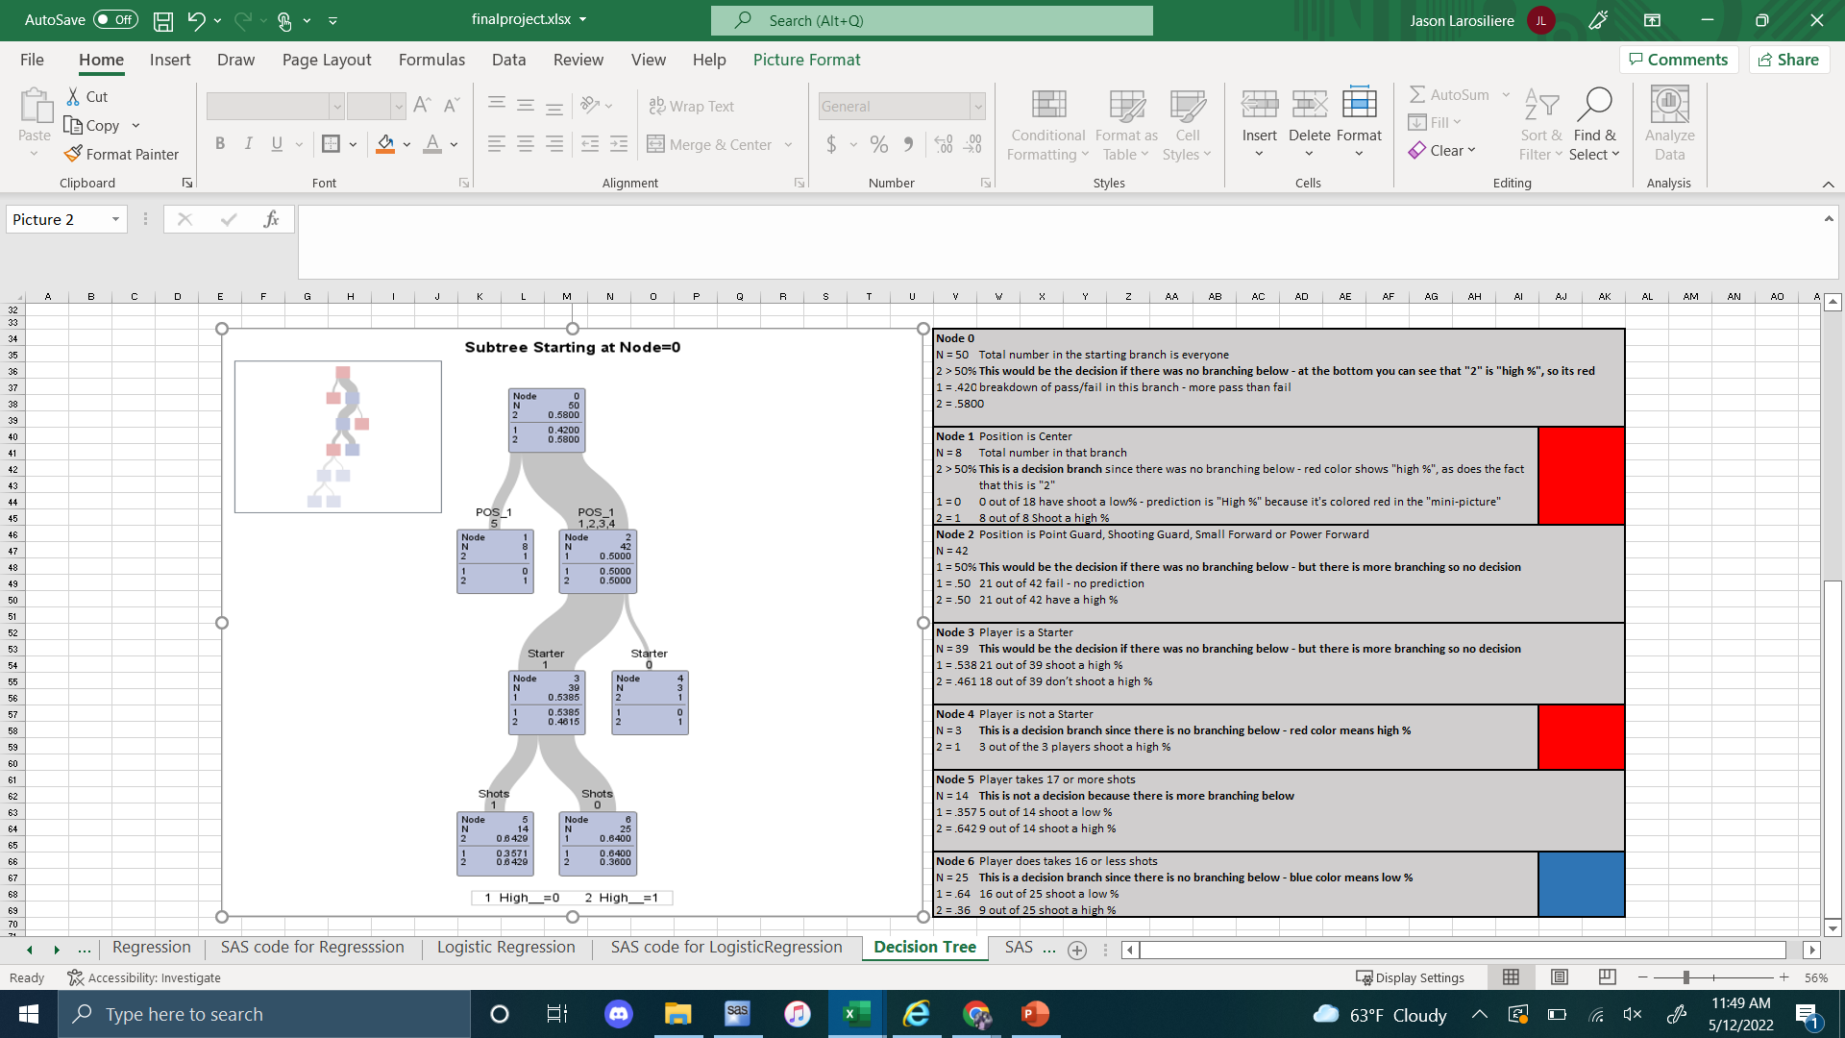
Decision Tree Graph w Description

Slide 13
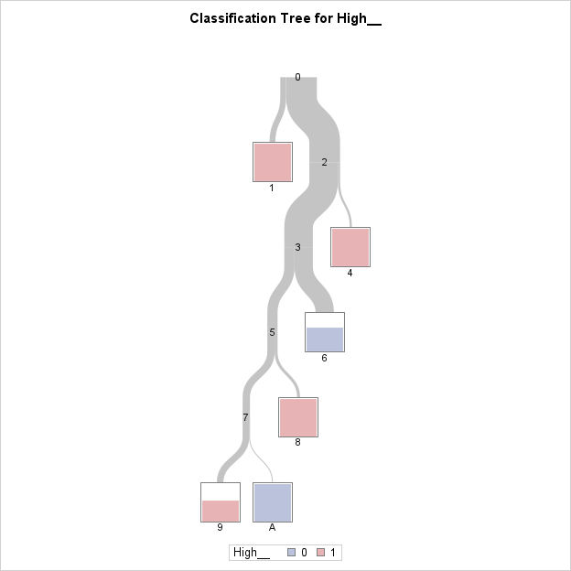
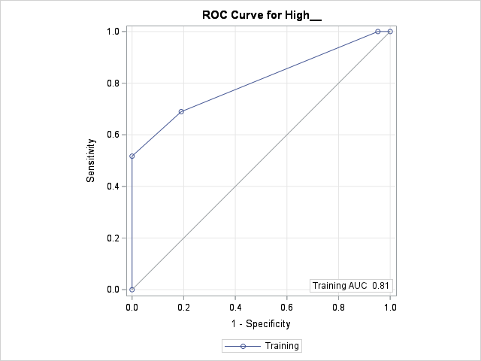
Decision Tree Graphs –continued

Slide 14
Decision Tree conclusion
After running the decision tree, the important variables that came up was position, starter or bench player, whether they take a lot of shots or not, and their dominant hand. Position was the most important variable in determining a players’ field goal percentage which was almost twice as important as being the x-variables- being a starter and number of shots taken. According to the decision tree, Node 1 which was red was a decision branch. Being only a center will lead to shooting a high %. This goes with what I said earlier, a center usually lives in the paint where you’re taking mostly layups and dunks. Therefore, there is no surprise for a center to shoot above 45%. Node 4 which was red is also a decision branch given the player is not a starter he shoots a high % from the field. The number of players in this node is 3 which is not really enough to make an actual generalization on the x-variable. However, the random 50 players I chose did come from the highest point getters in the league. As a result, any bench player high enough to be on this list is capable of scoring just as much as some starters. A bench player who does not shoot well will not see the floor as often as other players therefore wouldn’t make the original list of 50 players. The last decision branch was Node 6 which was blue which means the fg% is less than 45%. Given the player takes less than 17 shots per game he is decided to shoot a low % from the field.

Slide 15
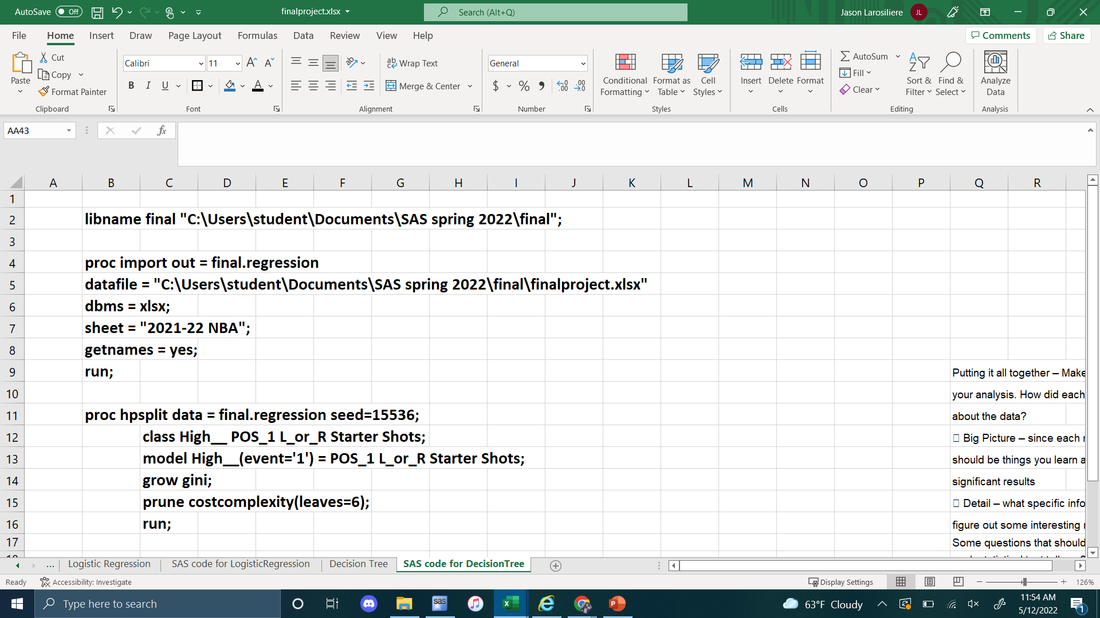
Decision Tree SAS code

